Slide 1
Naïve Bayes
Conditional probability
Know what Naïve Bayes is
Algorithm - steps
Process - body
output
Evaluation methods
Evaluation measures
Supervise Machine learning algorithm

Slide 2
EVENTS
An event is simply the outcome of a random experiment.
Getting a heads when we toss a coin is an event.
Getting a 6 when we roll a fair die is an event.
We associate probabilities to these events by defining the event and the sample space.
The sample space is nothing but the collection of all possible outcomes of an experiment. This means that if we perform a particular task again and again, all the possible results of the task are listed in the sample space.
For example: A sample space for a single throw of a die will be {1,2,3,4,5,6}.
One of these is bound to occur if we throw a die.
An event can also be a combination of different events.

Slide 3
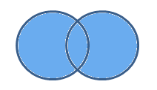
Union of Events
We can define an event (C) of getting a 4 or 6 when we roll a fair die.
Here event C is a union of two events:
Event A = Getting a 4
Event B = Getting a 6
P (C) = P (A ꓴ B)
i.e. probability of (A ꓴ B) when we are interested in combined probability of two (or more) events.

Slide 4
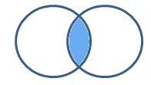
Intersection of Events
Let C be the event of getting a multiple of 2 and 3 when you throw a fair die.
Event A = Getting a multiple of 2 when you throw a fair die
Event B = Getting a multiple of 3 when you throw a fair die
Event C = Getting a multiple of 2 and 3
Event C is an intersection of event A & B.
P (C) = P (A ꓵ B)
shaded region is the probability of both events A and B occurring together.

Slide 5
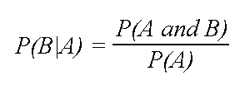
Conditional probability
The conditional probability of an event B is the probability that the event will occur given the knowledge that an event A has already occurred.
This probability is written P(B|A), notation for the probability of B given A.
In the case where events A and B are independent (where event A has no effect on the probability of event B), the conditional probability of event B given event A is simply the probability of event B, that is P(B).
If events A and B are not independent, then the probability of the intersection of A and B (the probability that both events occur) is defined by P(A and B) = P(A)P(B|A).
From this definition, the conditional probability P(B|A) is easily obtained by dividing by P(A):

Slide 6
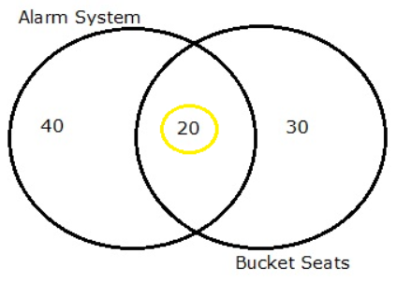
Examples
In a group of 100 sports car buyers, 40 bought alarm systems, 30 purchased bucket seats, and 20 purchased an alarm system and bucket seats. If a car buyer chosen at random bought an alarm system, what is the probability they also bought bucket seats?
Step 1: Figure out P(A). It’s given in the question as 40%, or 0.4.
Step 2: Figure out P(A∩B). This is the intersection of A and B: both happening together. It’s given in the question 20 out of 100 buyers, or 0.2.
Step 3: Insert your answers into the formula:
P(B|A) = P(A∩B) / P(A) = 0.2 / 0.4 = 0.5.
The probability that a buyer bought bucket seats, given that they purchased an alarm system, is 50%.

Slide 7

Examples
What is the probability a randomly selected person is male, given that they own a pet?
Step 1: P(M|PO) = P(M∩PO) / P(PO)
Step 2: Figure out P(M∩PO) from the table. The intersection of male/pets (the intersection on the table of these two factors) is 0.41.
Step 3: Figure out P(PO) from the table. From the total column, 86% (0.86) of respondents had a pet.
Step 4: Insert your values into the formula:
P(M|PO) = P(M∩PO) / P(M) = 0.41 / 0.86 = 0.477, or 47.7%.

Slide 8
Conditional Probability in Real Life
Conditional probability is used in many areas, including finance, insurance and politics.
For example, the re-election of a president depends upon the voting preference of voters and perhaps the success of television advertising — even the probability of the opponent making gaffes during debates!
The weatherman might state that your area has a probability of rain of 40 percent. However, this fact is conditional on many things, such as the probability of…
…a cold front coming to your area.
…rain clouds forming.
…another front pushing the rain clouds away.
We say that the conditional probability of rain occurring depends on all the above events.

Slide 9
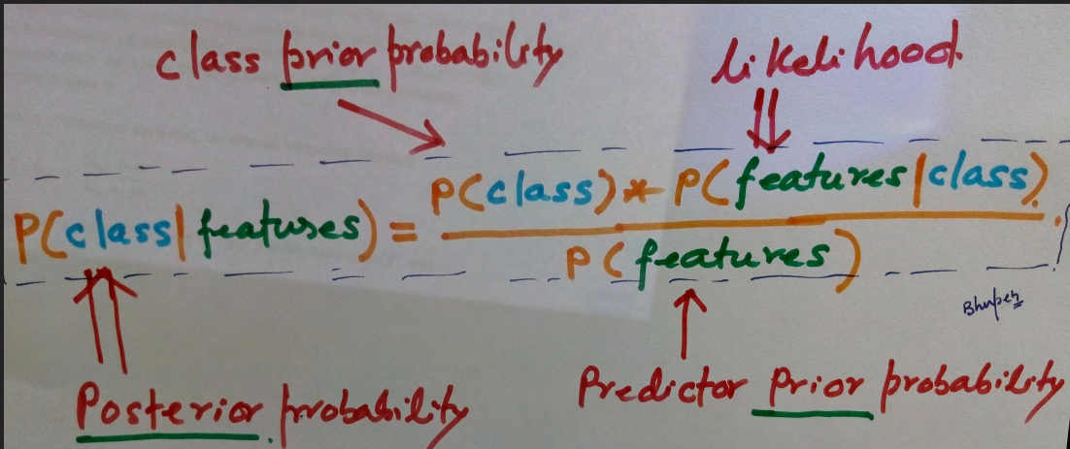
Summarizing nb
P(B|A) = P(A∩B) / P(A)

Slide 10
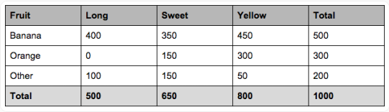
Naïve Bayes
let’s say we have data on 1000 pieces of fruit.
The fruit being a Banana, Orange or some Other fruit
imagine we know 3 features of each fruit,
long or not,
sweet or not and
yellow or not

Slide 11
Naïve Bayes
So from the table what do we already know?
50% of the fruits are bananas
30% are oranges
20% are other fruits
Based on our training set we can also say the following:
From 500 bananas
400 (0.8) are Long, 350 (0.7) are Sweet and 450 (0.9) are Yellow
Out of 300 oranges
0 are Long, 150 (0.5) are Sweet and 300 (1) are Yellow
From the remaining 200 fruits,
100 (0.5) are Long, 150 (0.75) are Sweet and 50 (0.25) are Yellow
Can we predict the class of another fruit as it’s introduced to us?

Slide 12
question
So let’s say we’re given the features of a piece of new fruit and we need to predict the class. We are told that the fruit is Long, Sweet and Yellow.
Is it a Banana? Is it an Orange? Or Is it some Other Fruit?

Slide 13

Solution
P(O | E1, E2, E3, E4)
= [[P(E1|O) * P(E2|O) * P(E3|O) * P(E4|O)] [(P(E1) * P(E2) * P(E3) * P(E4))]] * P(O)
P(Banana/Long, Sweet and Yellow)
= [[P(Long/Banana) * p(Sweet/Banana) * P(Yellow/Banana)] [P(Long) * P(Sweet) * P(Yellow)]] * P(banana)

Slide 14
Solution

Slide 15
Naïve Bayes classifier in scikit learn
3 types of Naive Bayes model under scikit learn library:
Gaussian: It is used in classification and it assumes that features follow a normal distribution.
Multinomial: It is used for discrete counts. For example, a text classification problem where we have frequency counts of features in a vector. The multinomial distribution normally requires integer feature counts. However, in practice, fractional counts such as tf-idf may also work.
Bernoulli: The binomial model is useful if your feature vectors are binary (i.e. zeros and ones). One application would be text classification with ‘bag of words’ model where the 1s & 0s are “word occurs in the document” and “word does not occur in the document” respectively.

Slide 16
Naïve Bayes vs KNN
KNN | Naïve Bayes
KNN-classifier can be used when data set is small enough | if data size will keep increasing its wise to choose Naive Bayes.
Lazy learner | is an eager learning classifier and it is much faster than K-NN.
are based on learning by resemblance (distance) | Use when the dimensionality of the inputs is high
value of k is too small, then K-NN classifier may be vulnerable to over fitting Value of k is too large, the nearest-neighbor classifier may misclassify the test sample | requires a very large number of records to obtain good results
robust to noisy training data | strong assumption on the shape of the data distribution, i.e. any two features are independent given the output class (refer correlation/COV analysis)
Good for multi-class labels | Zero occurrence of a feature leads to 0 probability – a major drawback of NB

